Slide 1
Excel Project
Student Name :- Darandale Pratik
THIS PROJECT IS BASED ON CARS DISTRIBUTION ACROSS THE WORLD, AS PER THE DATA SET, GOT SOME INSIGHTS FOR BETTER UNDERSTANDING
THIS DATASETS CONSIST OF 11 COLUMNS & 2501 ROWS
FROM THIS DATASET, THE FIELDS WHICH ARE USED AS FOLLOWS
MODEL, YEAR, PRICE, TRANSMISSION, MILEAGE, FUELTYPE, MPG, ENGINESIZE, COMPANY, COUNTRY, COLOR

Slide 2
QUESTIONS BASED ON DATASET
WHICH COUNTRY HAS GOT THE HIGHEST OR LOWEST PRICE DISTRIBUTION WITH RESPECT TO MODEL?
WHICH TRANSMISSION HAS THE MAXIMUM NUMBER OF CARS?
WHICH FUEL TYPE HAS THE MAXIMUM NUMBER OF CARS?
WHICH COMPANY HAS THE HIGHES NUMBER OF CARS?
HOW MUCH IS NUMBER OF MODELS DISTRIBUTION WITH RESPECT TO YEAR?
WHAT IS THE COMBINE SUM OF TOTAL PRICE OF THE MODEL
WHICH TYPE OF COMPANY HAS GOT THE HIGHEST NUMBER OF PRICE WITH RESPECT TO COUNTRY?
WHICH TYPE OF COLOR HAS HIGHER PRICE?
WHICH COMPANY AND FUEL TYPE GIVES THE MAXIMUM NUMBER OF CARS EITH RESPECT TO ENGINE TYPE?
WHICH FUEL TYPE CARS HAS HIGHER PRICE AMOUNG THE ALL COMPANY?

Slide 3
WHICH COUNTRY HAS GOT THE HIGHEST OR LOWEST PRICE DISTRIBUTION WITH RESPECT TO MODEL?
HIGHEST - SPAIN – 430 - $9,524,378.00 LOWEST – NORVAY – 146 - $2,988,424.00

Slide 4
WHICH TRANSMISSION HAS THE MAXIMUM NUMBER OF CARS?
TRANSMISSION - MANUAL
COUNT OF MODEL - 1044

Slide 5
WHICH FUEL TYPE HAS THE MAXIMUM NUMBER OF CARS?
MAXIMUM – DIESEL - 1141
MINIMUM – HYBRID - 3

Slide 6
WHICH COMPANY HAS THE HIGHES NUMBER OF CARS?
HIGHEST – AUDI - 2192
LOWEST - HYUNDAI - 1

Slide 7
HOW MUCH IS NUMBER OF MODELS DISTRIBUTION WITH RESPECT TO YEAR?
YEAR - 2019
COUNT OF MODEL - 620

Slide 8
WHAT IS THE COMBINE SUM OF TOTAL PRICE OF THE MODEL
HIGHEST - Q3 - $6,349,222.00
LOWEST – IONIQ - $12,800.00

Slide 9
WHICH TYPE OF COMPANY HAS GOT THE HIGHEST NUMBER OF PRICE WITH RESPECT TO COUNTRY?
AUDI - SPAIN - $8,709,837.00
BMW - SPAIN - $97,714.00
FORD - POLAND - $15,975.00
HYUNDAI - SWIDEN - $12,800.00
SKODA - SPAIN - $37,740.00
TOYOTA - SPAIN - $390,089.00
VW - POLAND - $309,491.00

Slide 10
WHICH TYPE OF COLOR HAS HIGHER PRICE?
WHITE - $15,379,859.00

Slide 11
WHICH COMPANY AND FUEL TYPE GIVES THE MAXIMUM NUMBER OF CARS EITH RESPECT TO ENGINE TYPE?
AUDI - 2 - 1,054

Slide 12
WHICH FUEL TYPE CARS HAS HIGHER PRICE AMOUNG THE ALL COMPANY?
DIESEL - $25,442,905.00

Slide 13
CONCLUSION
FROM THE DATA SET, WE GOT CONCLUSION AS FOLLOWS,
SPAIN HAS HIGHEST PRICE DISTRIBUTION WITH HIGHEST CAR MODELS AND NORWAY HAS LOWEST PRICE DISTRIBUTION
THE MANUAL TRASMISSION HAS MAXIMUM NO OF CAR MODELS
DIESEL FUEL TYPE HAS MAXIMUM NO OF CAR MODELS AND HYBRID HAS MINIMUM NO OF CAR MODELS
AUDI HAS HIGHEST NO OF CARS AND HYUNDAI HAS LOWEST NO OF CARS
IN 2019 620 CARS HAS DITRIBUTED OVER THE WORLD
Q3 MODEL HAS HIGHEST TOTAL SUM OF PRICE WITH 303 CAR MODELS
IN SPAIN AUDI HAS HIGHEST SUM OF PRICE
WHITE COLOR OF CARS HAS HIGHER TOTAL PRICE
AUDI GIVS THE MAXIMUM NO OF CARS WITH ENGINE TYPE 2
DIESEL FUEL TYPE CAR HAS HIGHER PRICE AMOUNG ALL THE COMAPNYS

Slide 14
SOURCE DATA
DATASET
https://www.kaggle.com/aishwaryamuthukumar/cars-dataset-audi-bmw-ford-hyundai-skoda-vw
VIDEO PRESENTATION LINK
https://drive.google.com/file/d/1ssU9IVFcHpuHacEFMf5b9NReG2vAxItg/view?usp=sharing

Slide 15
DYNAMIC DASHBORAD

Slide 16
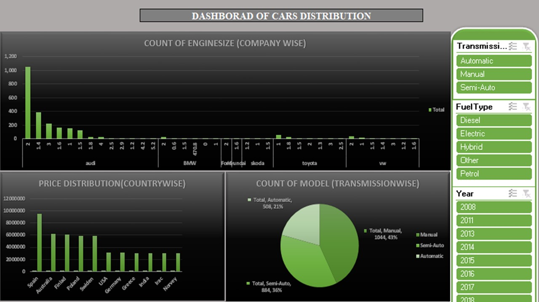

Slide 17
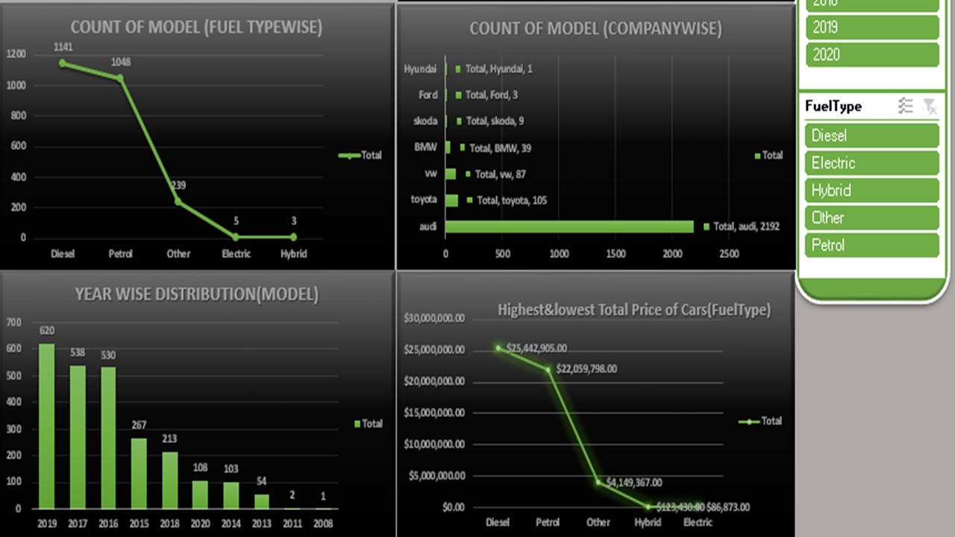

Slide 18
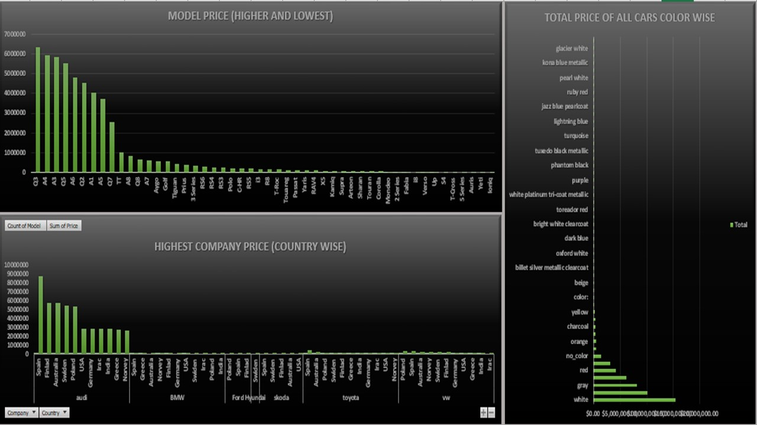

Slide 19
THANK YOU

